Slide 1

Static and Dynamic Analysis: A Comprehensive Overview
Static and dynamic analysis are crucial tools in software development, helping identify defects and vulnerabilities before they cause problems. This presentation will delve into the intricacies of each analysis method, highlighting their benefits, limitations, and how they can be combined for optimal results.

Slide 2

What is Static Analysis?
Static analysis is a method of examining software code without executing it. It involves analyzing the source code to detect potential issues, such as bugs, security vulnerabilities, and code quality problems.
Code Review
Automated Tools
This involves manually examining the code for potential problems. It is a time-consuming process, but it can be very effective in identifying complex issues that may not be caught by automated tools.
These tools can automatically analyze large amounts of code, providing a quick and efficient way to identify potential problems. They can often detect a wide range of issues that may not be obvious to human eyes.

Slide 3

Benefits of Static Analysis
Static analysis offers numerous advantages for software development, ultimately leading to more robust and secure applications.
1
Early Bug Detection
2
Improved Code Quality
Static analysis identifies defects in the early stages, reducing the cost and time required to fix them later in the development cycle.
Static analysis helps ensure that the code adheres to coding standards and best practices, leading to more maintainable and reliable software.
3
Enhanced Security
4
Reduced Development Costs
Static analysis helps identify potential security vulnerabilities, such as buffer overflows and SQL injection, reducing the risk of attacks.
By catching errors early, static analysis reduces the overall development cost by minimizing the time and effort required to fix issues.

Slide 4
Limitations of Static Analysis
While static analysis is a powerful technique, it has certain limitations that need to be considered.
False Positives
Limited Scope
Complexity
Static analysis tools may flag potential issues that are not actual problems, leading to unnecessary investigation and wasted time.
Static analysis cannot detect all types of errors, particularly those that arise from runtime behavior, such as resource leaks and deadlocks.
Analyzing complex code can be challenging for static analysis tools, especially when dealing with dynamic languages or codebases with multiple dependencies.

Slide 5

What is Dynamic Analysis?
Dynamic analysis focuses on observing the behavior of a program while it is running. It involves executing the code and monitoring its interactions with the system to identify potential issues.
1
Execution
The program is executed under controlled conditions, allowing analysts to observe its behavior and identify any deviations from expected behavior.
2
Monitoring
Various tools and techniques are used to monitor the program's execution, including memory usage, network traffic, and system calls.
3
Analysis
The collected data is analyzed to identify potential issues, such as performance bottlenecks, memory leaks, and security vulnerabilities.

Slide 6




Benefits of Dynamic Analysis
Dynamic analysis complements static analysis by providing insights into runtime behavior and identifying issues that may not be apparent during code review.
Runtime Behavior
Dynamic analysis provides a comprehensive understanding of the program's behavior during execution, revealing issues that may not be evident in the source code.
Performance Optimization
By analyzing runtime performance metrics, dynamic analysis helps identify performance bottlenecks and optimize the code for better efficiency.
Security Testing
Dynamic analysis techniques, such as fuzzing and penetration testing, are essential for identifying security vulnerabilities and strengthening the software against attacks.

Slide 7

Limitations of Dynamic Analysis
Dynamic analysis faces limitations due to the complexities of real-world environments and the difficulty of creating comprehensive test cases.
Limited Coverage
Dynamic analysis is limited to the scenarios tested, making it difficult to identify issues that may occur in untested situations.
Performance Overhead
Monitoring and analyzing a program's execution can introduce performance overhead, potentially affecting the accuracy of the results.
Resource Intensive
Dynamic analysis can require significant resources, including time, hardware, and expertise, making it challenging for smaller teams.

Slide 8





Combining Static and Dynamic Analysis
Combining static and dynamic analysis offers a comprehensive approach to software development, maximizing the benefits of each technique and mitigating their limitations.
Improved Security
Early Bug Detection
Static analysis identifies potential vulnerabilities, while dynamic analysis confirms their exploitability, leading to more robust security.
Static analysis catches errors during development, while dynamic analysis exposes those that emerge at runtime, ensuring a cleaner codebase.
Performance Enhancement
Enhanced Collaboration
Static analysis identifies performance issues in the code, while dynamic analysis analyzes the program's runtime performance for optimization.
Combining both methods provides a holistic understanding of the software, fostering better collaboration between development and security teams.

Slide 9

Tools for Static and Dynamic Analysis
Several tools are available for static and dynamic analysis, offering a variety of features and capabilities to suit different needs.
1
Static Analysis Tools
2
Dynamic Analysis Tools
Examples include SonarQube, Coverity, and FindBugs. These tools can analyze code for various issues, including bugs, vulnerabilities, and coding standards.
Examples include AppDynamics, Dynatrace, and JMeter. These tools monitor the behavior of the program in real-time, providing insights into its performance and security.

Slide 10
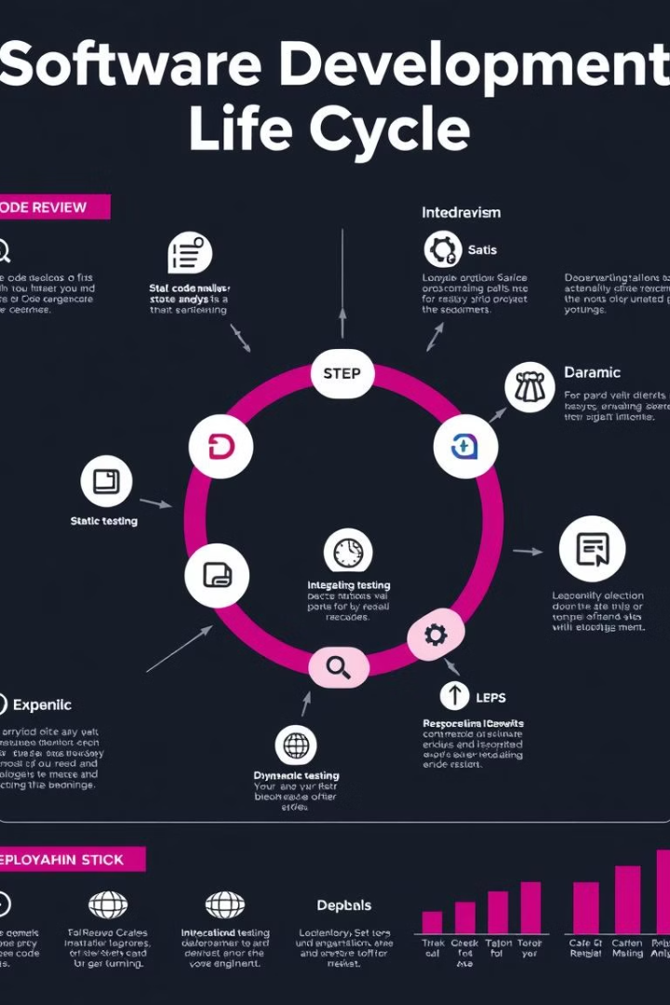
Conclusion and Key Takeaways
Static and dynamic analysis play vital roles in ensuring the quality, security, and performance of software. By combining these techniques, development teams can build robust and secure applications.
Early Detection
Runtime Behavior
Static analysis is key for early detection of bugs and security vulnerabilities.
Dynamic analysis provides insights into the program's runtime behavior, revealing potential issues.
Comprehensive Approach
Combining static and dynamic analysis offers a comprehensive and effective approach to software development.

